Slide 1



Technical Facilities of Infrimation
Prepared & Presented by: Mirlan Nurbekov, Lecturer
Office hours: Friday 9:00–17:00
AlaToo IT & Business College
Fall 2025

Slide 2

Learning objectives
- Understand the concept of encryption
- Differentiate between symmetric and asymmetric encryption
- Identify common algorithms used in both types
- Perform basic file encryption and decryption

Slide 3

What is encryption?

Slide 4

What is encryption?
Encryption is the process of converting readable information (some data) into an unreadable form (ciphertext) using a secret key with use of algorithm.

Slide 5
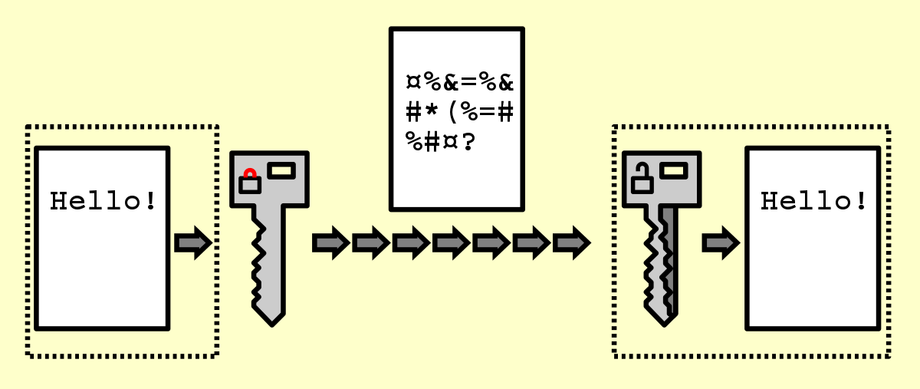
Demo - 0000
_I54hL9b2JXIkS5gFMInUCD5C1AGQZZUhCeExhLUcmM=

Slide 6
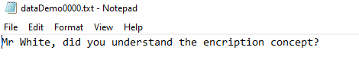
Demo - 0000

Slide 7
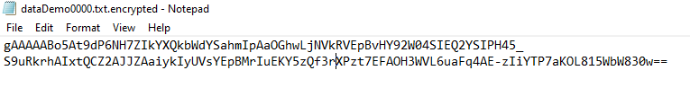
Demo - 0000
Ciphertext

Slide 8
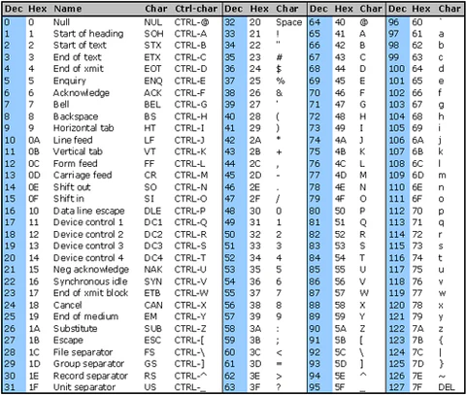

Slide 9
Demo - 0000
Mr White, did you understand the encryption concept?
Converted to ASCII(hex) 4d 72 20 57 68 69 74 65 2c 20 64 69 64 20 79 6f 75 20 75 6e 64 65 72 73 74 61 6e 64 20 74 68 65 20 65 6e 63 72 79 70 74 69 6f 6e 20 63 6f 6e 63 65 70 74 3f

Slide 10
Demo - 0000
AES-256 encryption (Advanced Encryption Standard)
It requires a 256-bit key (32 bytes). It is a symmetric encryption algorithm, meaning the same key is used to encrypt and decrypt data.

Slide 11
Demo - 0000
The AES-256 encryption algorithm works by taking data and the key, then scrambling the data 14 times(rounds) in a way that can only be undone with the same key. The AES operates on 16-byte blocks. It uses meanss use 256 bits for key generation.
Each round applies SubBytes, ShiftRows, MixColumns, AddRoundKey (except final round has no MixColumns).

Slide 12
AES encryption algorithm supports three key sizes:
AES-128 -> 10 rounds
AES-192 -> 12 rounds
AES-256 -> 14 rounds

Slide 13
AES-128 → block size = 128 bits (16 bytes), key size = 128 bits (16 bytes)
AES-192 → block size = 128 bits (16 bytes), key size = 192 bits (24 bytes)
AES-256 → block size = 128 bits (16 bytes), key size = 256 bits (32 bytes)

Slide 14
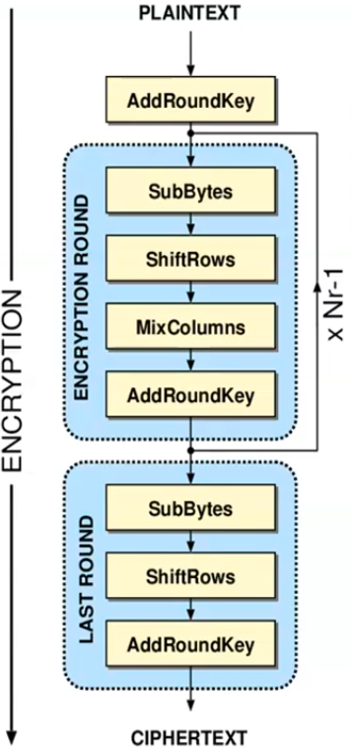

Slide 15
Demo - 0000
4d 72 20 57 68 69 74 65 2c 20 64 69 64 20 79 6f 75 20 75 6e 64 65 72 73 74 61 6e 64 20 74 68 65 20 65 6e 63 72 79 70 74 69 6f 6e 20 63 6f 6e 63 65 70 74 3f
16-byte block
Mr White, did yo
ASCII hex:
4d 72 20 57 68 69 74 65 2c 20 64 69 64 20 79 6f
SubBytes replaces each byte independently via the S-box. The substituted bytes (hex) would look like this:
ed a5 63 b1 3d 1f 92 8f 7a 63 0e 1f 0e 63 9c 2a

Slide 16
SubBytes -> substitution
ShiftRows, MixColumns -> permutation
AddRoundKey -> at the end of each round
128 bit -> 16 byte blocks (1 byte = 8 bits)
00 | 01 | 02 | 03 | 04 | 05 | 06 | 07 | 08 | 09 | 10 | 11 | 12 | 13 | 14 | 15 | 16

Slide 17
128 bit -> 16 byte blocks (1 byte = 8 bits)
byte 00 | byte 04 | byte 08 | byte 12
byte 01 | byte 05 | byte 09 | byte 13
byte 02 | byte 06 | byte 10 | byte 14
byte 03 | byte 07 | byte 11 | byte 15

Slide 18
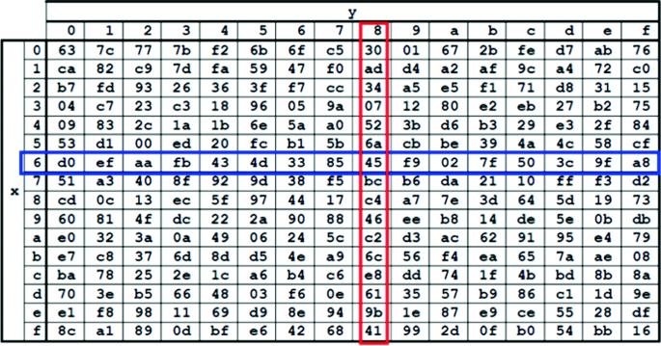
What happens to the text?
SubBytes is non-linear byte substitution step used in every round of AES, except the last round. It trasssforms each byte in the data block individually using S-box.(Substitution box) The substitution is invertible, meaning it can be reversed during decryption.

Slide 19
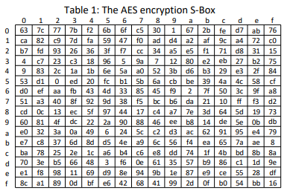
SubBytes S-box (16x16)

Slide 20
SubBytes
Each individual byte of state is mapped into a new byte in the following way: The left 4 bits of the byte are used as a row value and the rightmost 4 bits are used as a column value. They serve as invade values in the S-box to select the 8-bit output value

Slide 21
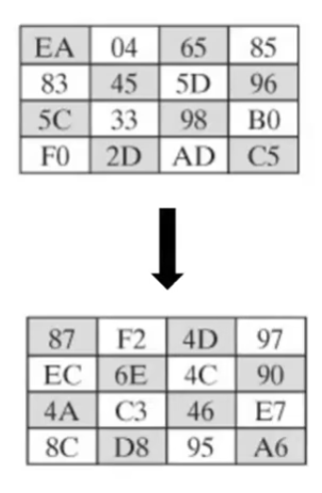
SubBytes

Slide 22
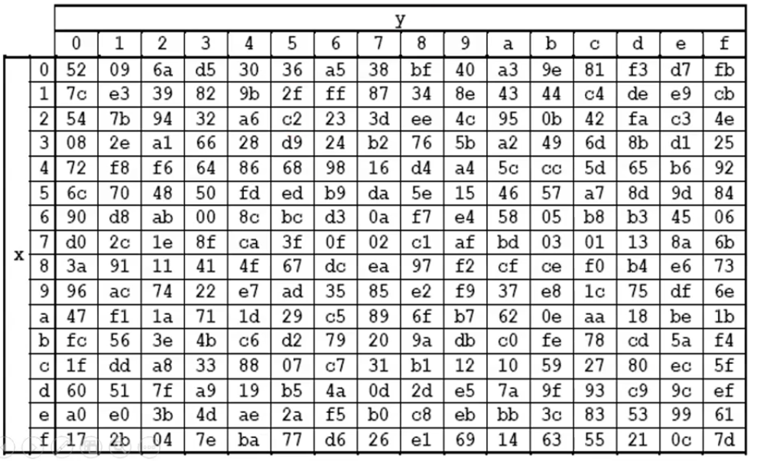
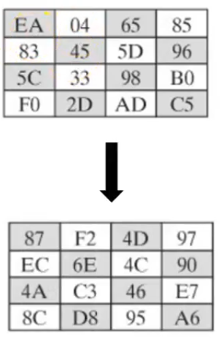
SubBytes - decryption

Slide 23
128 bit -> 16 byte blocks (1 byte = 8 bits)
byte 00 | byte 04 | byte 08 | byte 12
byte 01 | byte 05 | byte 09 | byte 13
byte 02 | byte 06 | byte 10 | byte 14
byte 03 | byte 07 | byte 11 | byte 15

Slide 24
SubBytes - result
Sbyte 00 | Sbyte 04 | Sbyte 08 | Sbyte 12
Sbyte 01 | Sbyte 05 | Sbyte 09 | Sbyte 13
Sbyte 02 | Sbyte 06 | Sbyte 10 | Sbyte 14
Sbyte 03 | Sbyte 07 | Sbyte 11 | Sbyte 15

Slide 25
ShiftRows - result
Sbyte 00 | Sbyte 04 | Sbyte 08 | Sbyte 12
Sbyte 05 | Sbyte 09 | Sbyte 13 | Sbyte 01
Sbyte 10 | Sbyte 14 | Sbyte 02 | Sbyte 06
Sbyte 15 | Sbyte 03 | Sbyte 07 | Sbyte 11

Slide 26
ShiftRows - step 0000
Sbyte 00 | Sbyte 04 | Sbyte 08 | Sbyte 12
Sbyte 01 | Sbyte 05 | Sbyte 09 | Sbyte 13
Sbyte 02 | Sbyte 06 | Sbyte 10 | Sbyte 14
Sbyte 03 | Sbyte 07 | Sbyte 11 | Sbyte 15

Slide 27
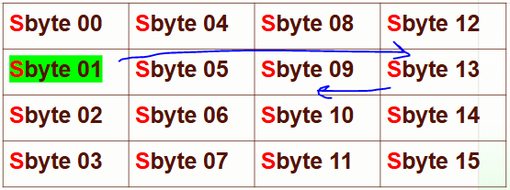
ShiftRows - step 0000

Slide 28
ShiftRows - step 0001 (resutl)
Sbyte 00 | Sbyte 04 | Sbyte 08 | Sbyte 12
Sbyte 05 | Sbyte 09 | Sbyte 13 | Sbyte 01
Sbyte 02 | Sbyte 06 | Sbyte 10 | Sbyte 14
Sbyte 03 | Sbyte 07 | Sbyte 11 | Sbyte 15

Slide 29
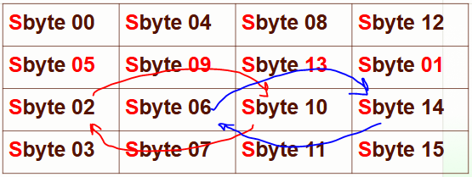
ShiftRows - step 0001

Slide 30
ShiftRows - step 0001 (resutl)
Sbyte 00 | Sbyte 04 | Sbyte 08 | Sbyte 12
Sbyte 05 | Sbyte 09 | Sbyte 13 | Sbyte 01
Sbyte 10 | Sbyte 14 | Sbyte 02 | Sbyte 06
Sbyte 03 | Sbyte 07 | Sbyte 11 | Sbyte 15

Slide 31
ShiftRows - step 0002
Sbyte 00 | Sbyte 04 | Sbyte 08 | Sbyte 12
Sbyte 05 | Sbyte 09 | Sbyte 13 | Sbyte 01
Sbyte 10 | Sbyte 14 | Sbyte 02 | Sbyte 06
Sbyte 03 | Sbyte 07 | Sbyte 11 | Sbyte 15

Slide 32
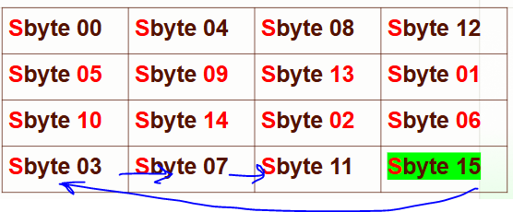
ShiftRows - step 0002

Slide 33
ShiftRows - step 0002 (result)
Sbyte 00 | Sbyte 04 | Sbyte 08 | Sbyte 12
Sbyte 05 | Sbyte 09 | Sbyte 13 | Sbyte 01
Sbyte 10 | Sbyte 14 | Sbyte 02 | Sbyte 06
Sbyte 15 | Sbyte 03 | Sbyte 07 | Sbyte 11

Slide 34
MixColumns - using matrix multiplication
C0
C1
C2
C3
Sbyte 00 | Sbyte 04 | Sbyte 08 | Sbyte 12
Sbyte 05 | Sbyte 09 | Sbyte 13 | Sbyte 01
Sbyte 10 | Sbyte 14 | Sbyte 02 | Sbyte 06
Sbyte 15 | Sbyte 03 | Sbyte 07 | Sbyte 11

Slide 35
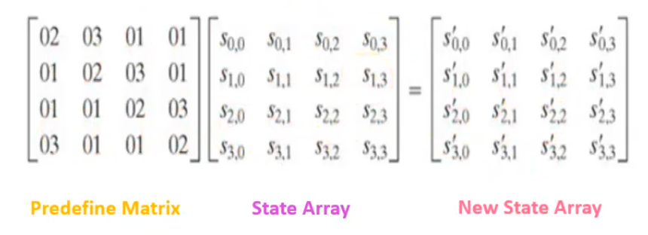
MixColumns operation uses Polynomial arithmetic over the finite field GF(2^8)

Slide 36
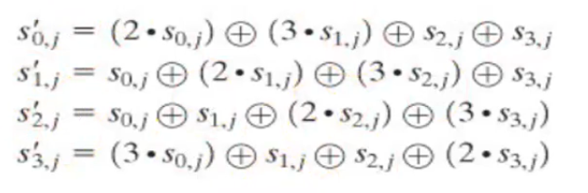
MixColumns calculations

Slide 37
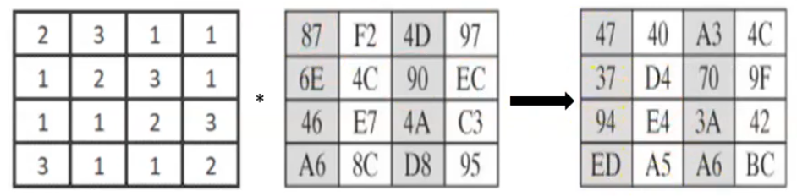
MixColumns operation uses polynomial arithmetic over the finite field GF(2^8)

Slide 38
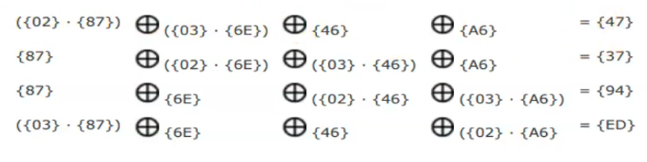
MixColumns operation uses polynomial arithmetic over the finite field GF(2^8)

Slide 39
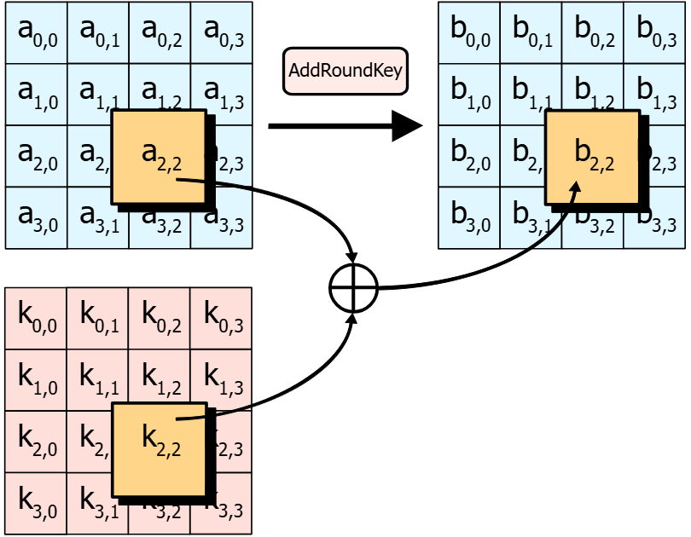
AddRoundKey
Each byte of the state (data block) is combined with the corresponding byte of the round key.
This is done using a simple XOR (exclusive OR) operation.

Slide 40
XOR (Exclusive OR)
XOR is a bitwise operation that compares two bits:
If the bits are the same → result is 0
If the bits are different → result is 1

Slide 41
XOR (Exclusive OR)
Plaintext byte:
Round key byte:
XOR result :
1 | 0 | 1 | 0 | 1 | 1 | 0 | 0
1 | 1 | 0 | 1 | 0 | 1 | 1 | 0
0 | 1 | 1 | 1 | 1 | 0 | 1 | 0

Slide 42
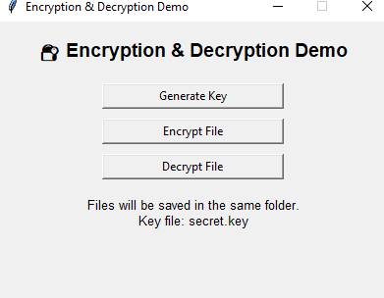
Demo - 0001

Slide 43
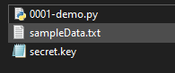
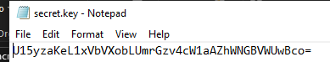
Demo - 0001

Slide 44
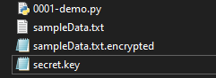
Demo - 0001

Slide 45

Symmetric and Asymmetric encryptions

Slide 46
Symmetric encryption
Uses one key for both encryption and decryption.
Both sender and receiver must have the same secret key.
It’s fast but requires secure key sharing.
Example: AES, DES, ChaCha20

Slide 47
Diffie-Hellman & Asymmetric Cryptography
Diffie-Hellman (DH) is a key exchange protocol, not an encryption algorithm.
Each party has a private number
They generate a public value from it
Combine the public value with the other party’s value to produce a shared secret

